Slide 1

Optimization Algorithms
Mini-batch
gradient descent
deeplearning.ai

Slide 2
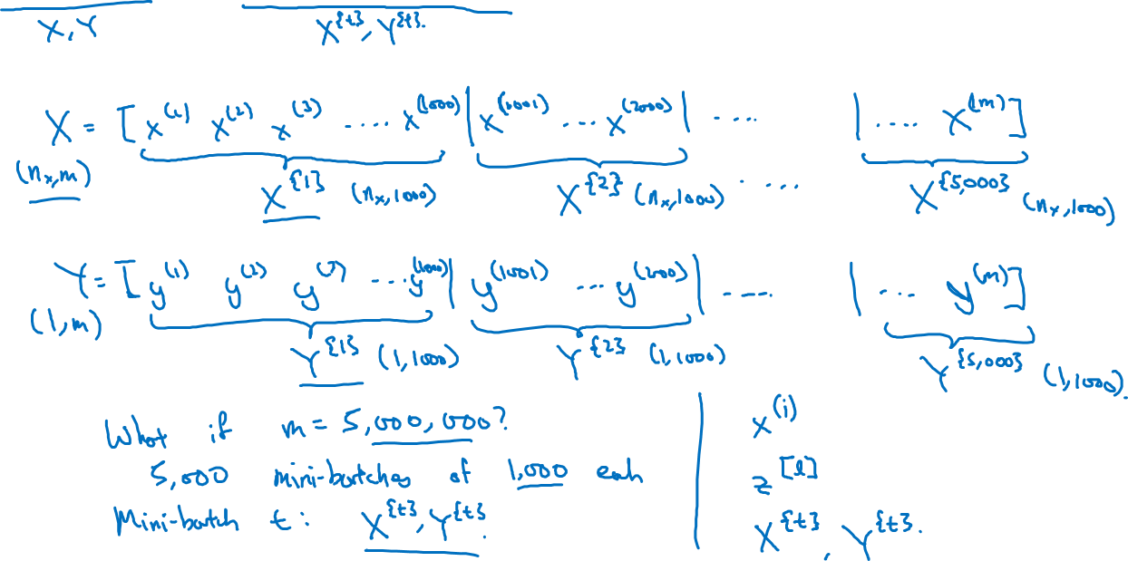
Batch vs. mini-batch gradient descent
Vectorization allows you to efficiently compute on m examples.

Slide 3
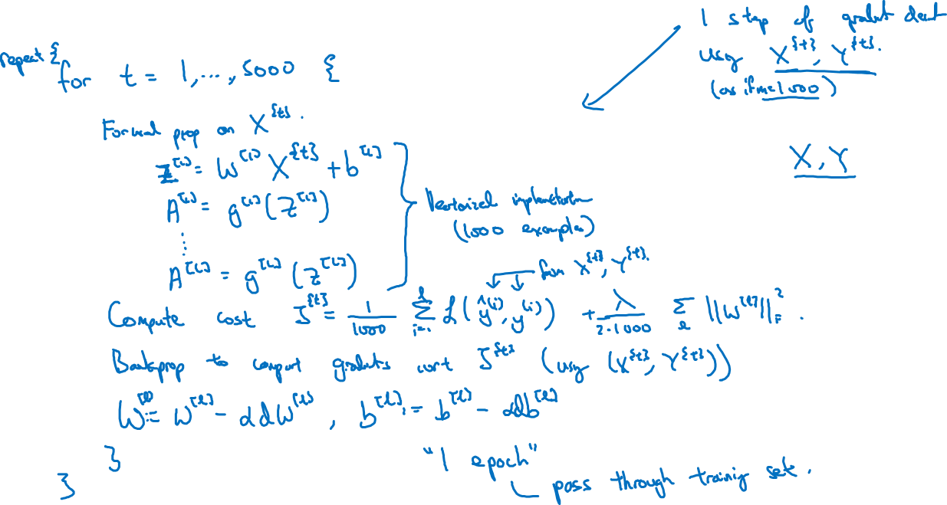
Mini-batch gradient descent

Slide 4
Optimization Algorithms
Understanding
mini-batch
gradient descent
deeplearning.ai

Slide 5
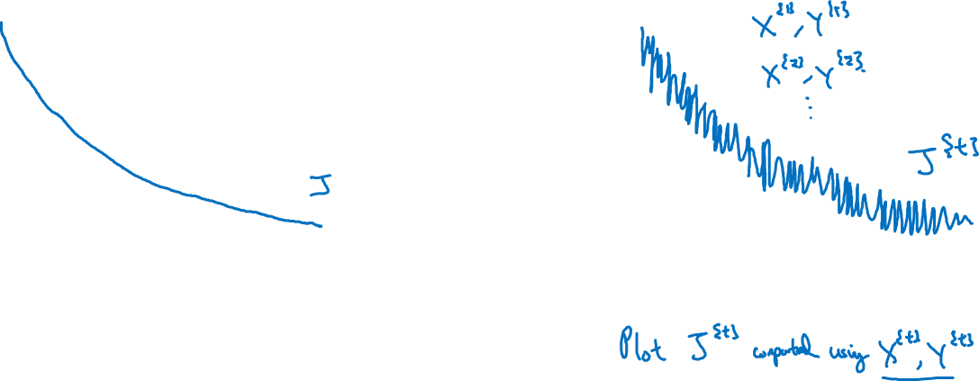
Training with mini batch gradient descent
Batch gradient descent
Mini-batch gradient descent
cost
cost
# iterations
mini batch # (t)

Slide 6
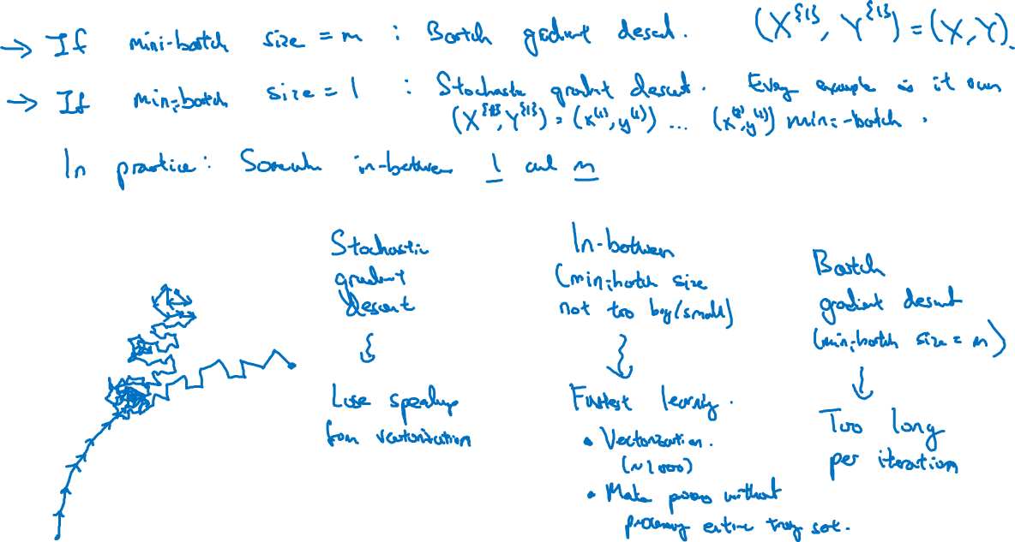
Choosing your mini-batch size

Slide 7
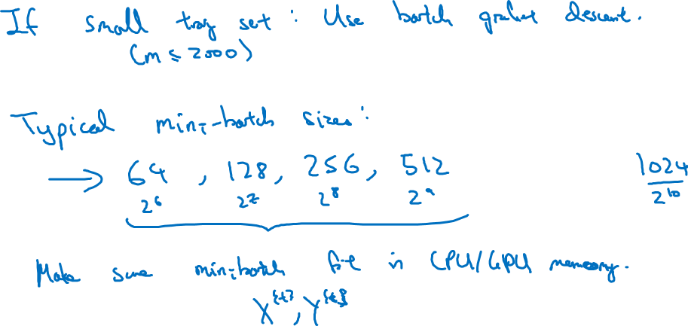
Choosing your mini-batch size

Slide 8
Optimization Algorithms
Exponentially weighted averages
deeplearning.ai

Slide 9
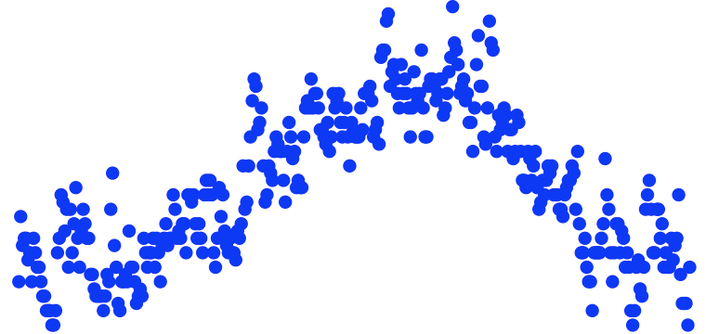
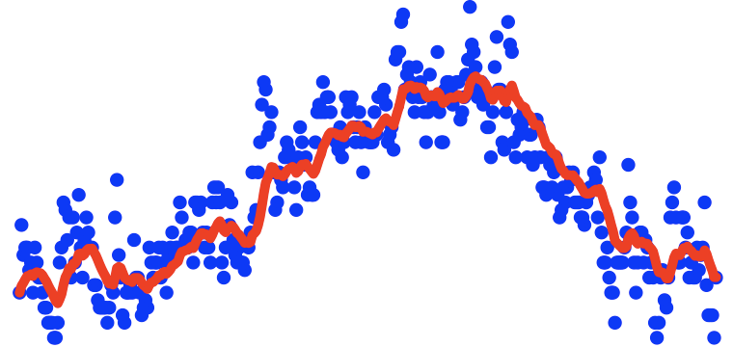




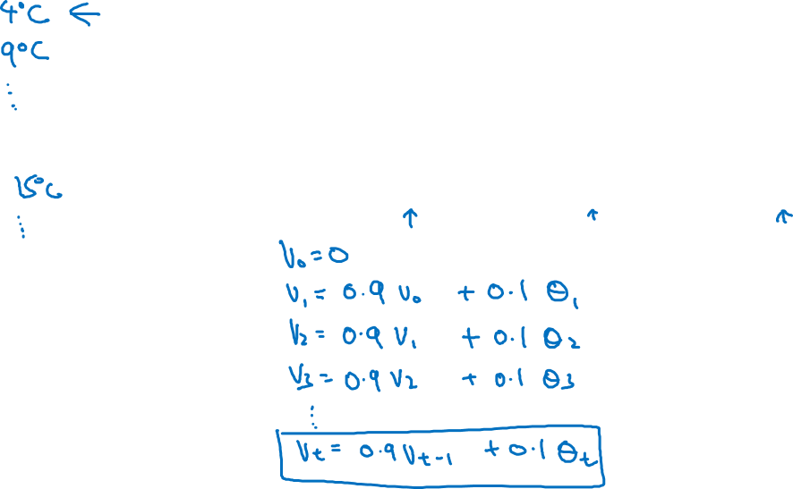

Temperature in London
$$θ_{1}=40°F$$
$$θ_{2}=49°F$$
$$θ_{3}=45°F$$
temperature
.
.
.
$$θ_{180}=60°F$$
$$θ_{181}=56°F$$
days
.
.
.

Slide 10
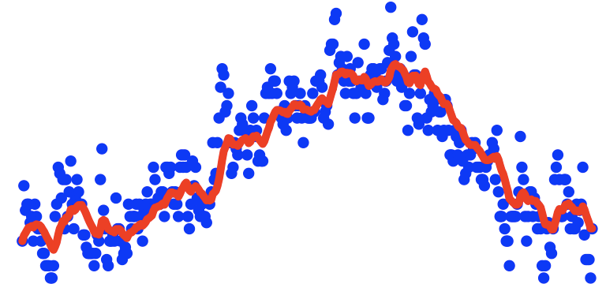
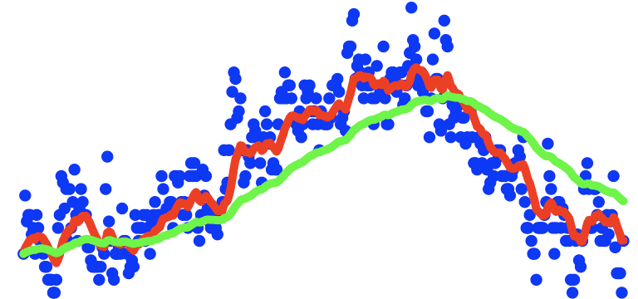
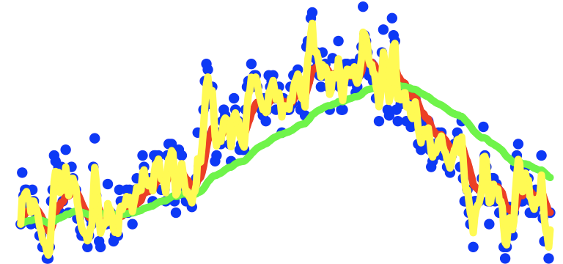
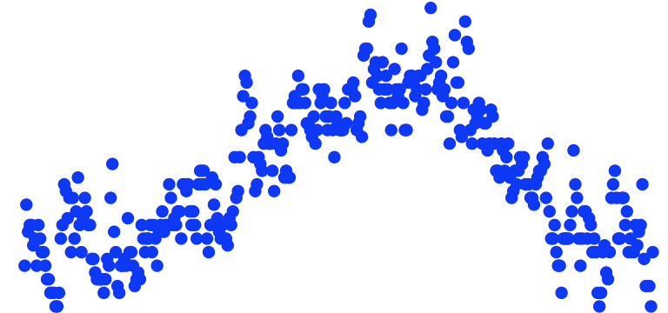
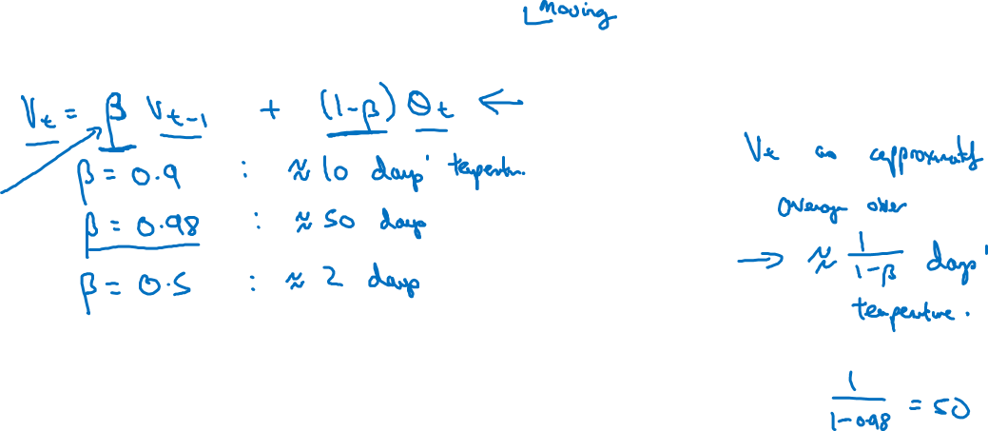
Exponentially weighted averages
temperature
days

Slide 11
Optimization Algorithms
Understanding exponentially weighted averages
deeplearning.ai

Slide 12

Exponentially weighted averages
$$v_{t}=βv_{t−1}+(1−β)θ_{t}$$
temperature
days

Slide 13
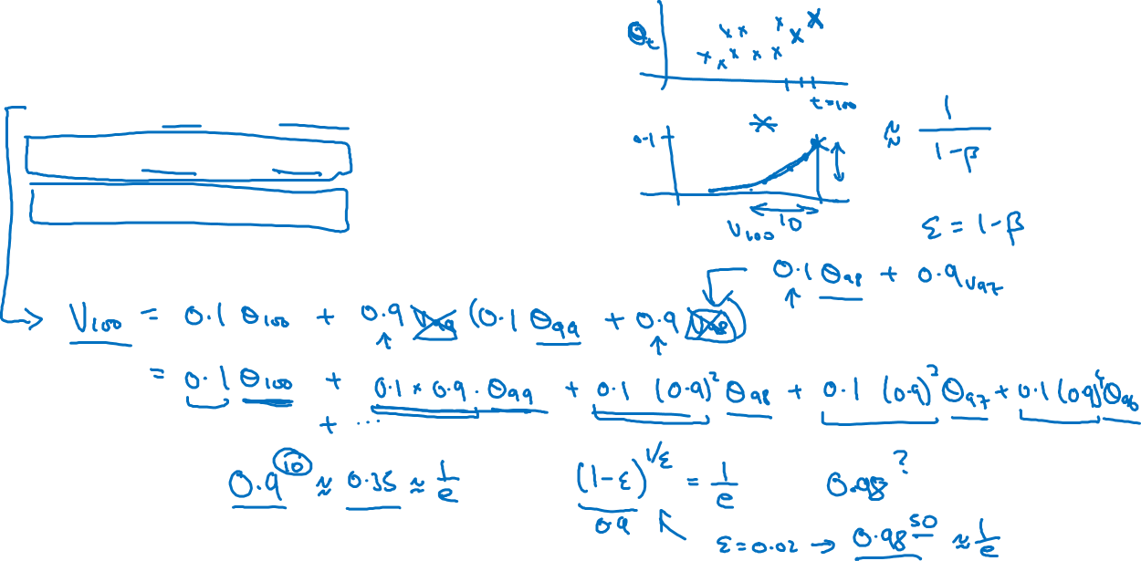





Exponentially weighted averages
$$v_{t}=βv_{t−1}+(1−β)θ_{t}$$
$$v_{100}=0.9v_{99}+0.1θ_{100}$$
$$v_{99}=0.9v_{98}+0.1θ_{99}$$
$$v_{98}=0.9v_{97}+0.1θ_{98}$$
$$…$$

Slide 14
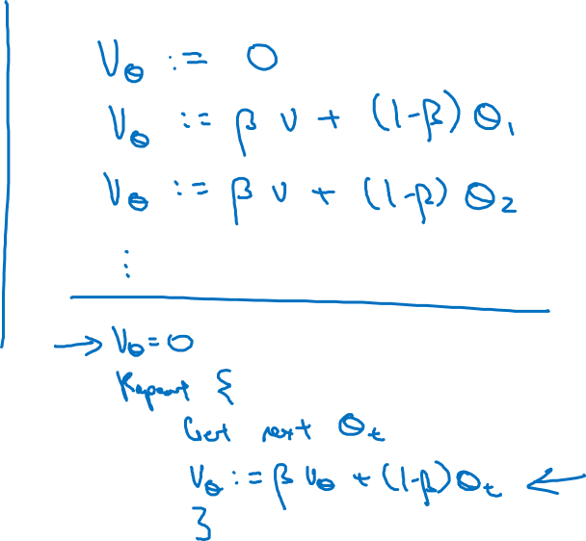





Implementing exponentially weighted averages
$$v_{0}=0$$
$$v_{1}=βv_{0}+(1−β) θ_{1}$$
$$v_{2}=βv_{1}+(1−β) θ_{2}$$
$$v_{3}=βv_{2}+(1−β) θ_{3}$$
$$…$$

Slide 15
Optimization Algorithms
Bias correction
in exponentially
weighted average
deeplearning.ai

Slide 16
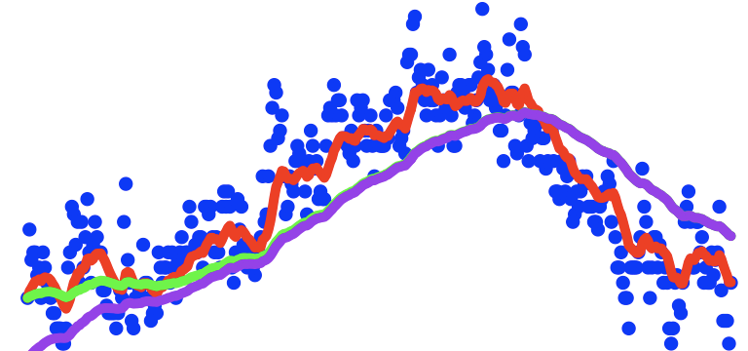
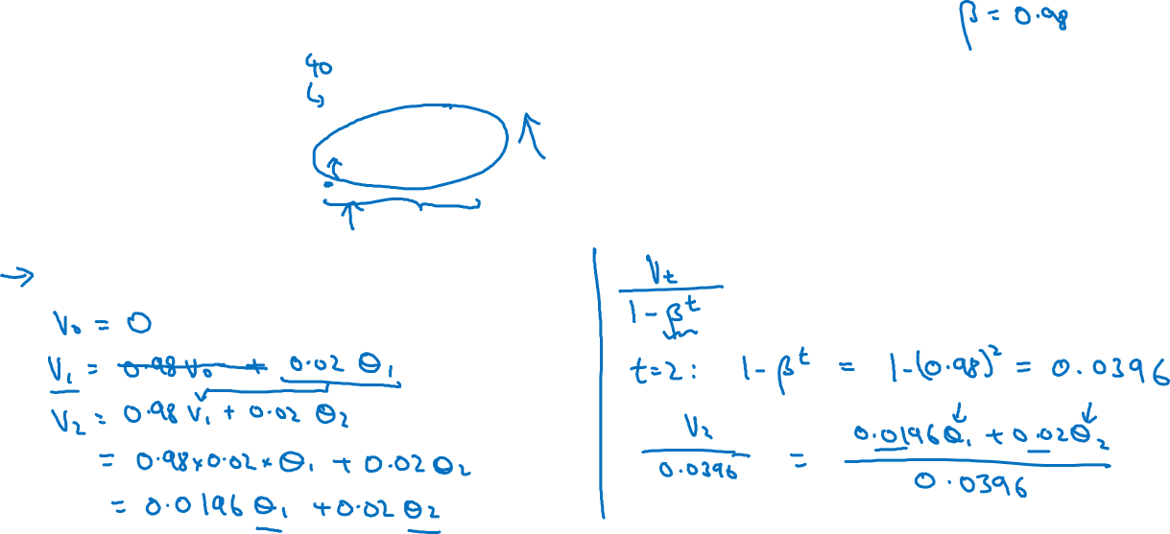

Bias correction
temperature
days
$$v_{t}=βv_{t−1}+(1−β)θ_{t}$$

Slide 17
Optimization Algorithms
Gradient descent with momentum
deeplearning.ai

Slide 18
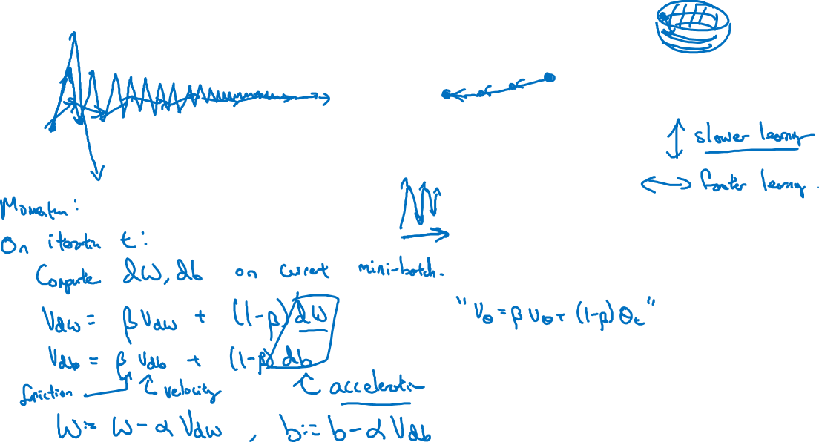
Gradient descent example

Slide 19




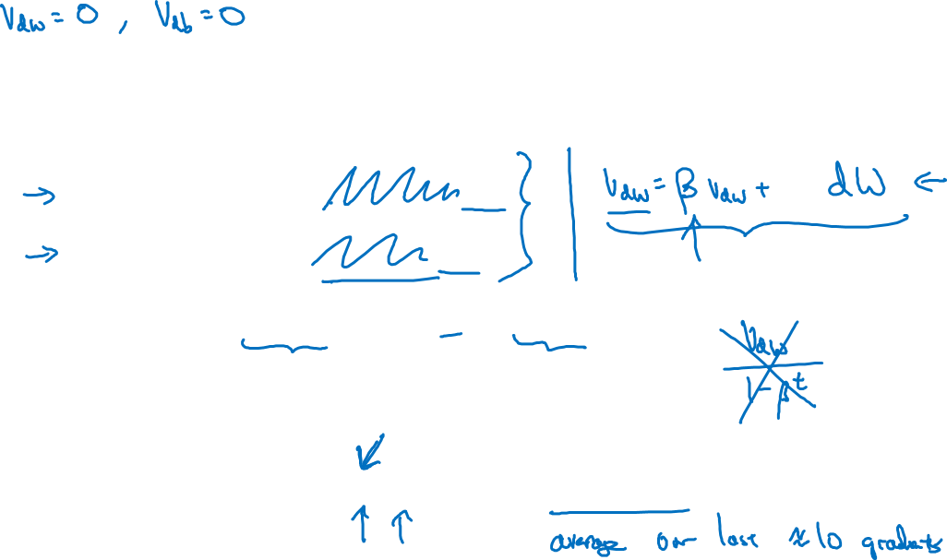
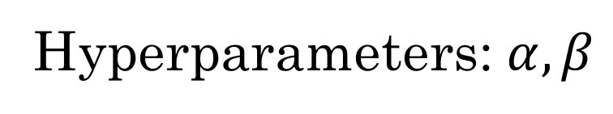


Implementation details
$$On iteration t:$$
Compute $dW,db$on the current mini-batch
$$v_{dW}=βv_{dW}+\left(1−β\right)dW$$
$$v_{db}=βv_{db}+\left(1−β\right)db$$
$$W=W−αv_{dW},$$
$$b=b−αv_{db}$$
Hyperparameters: $α,β$
$$β=0.9$$

Slide 20
Optimization Algorithms
RMSprop
deeplearning.ai

Slide 21
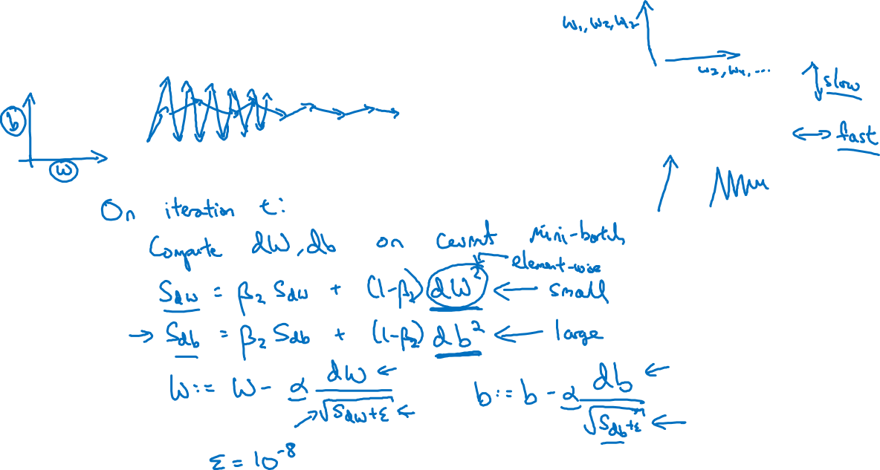
RMSprop

Slide 22
Optimization Algorithms
Adam optimization
algorithm
deeplearning.ai

Slide 23
Adam optimization algorithm
yhat = np.array([.9, 0.2, 0.1, .4, .9])

Slide 24

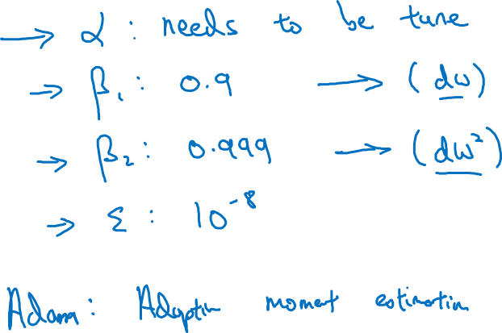
Hyperparameters choice:
Adam Coates

Slide 25
Optimization Algorithms
Learning rate
decay
deeplearning.ai

Slide 26
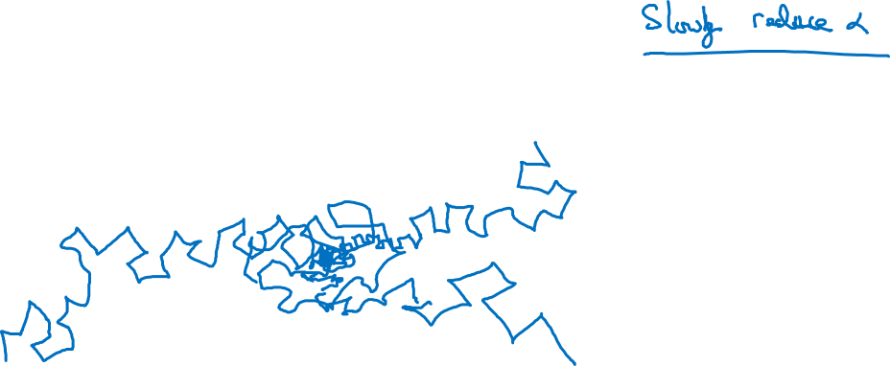
Learning rate decay

Slide 27
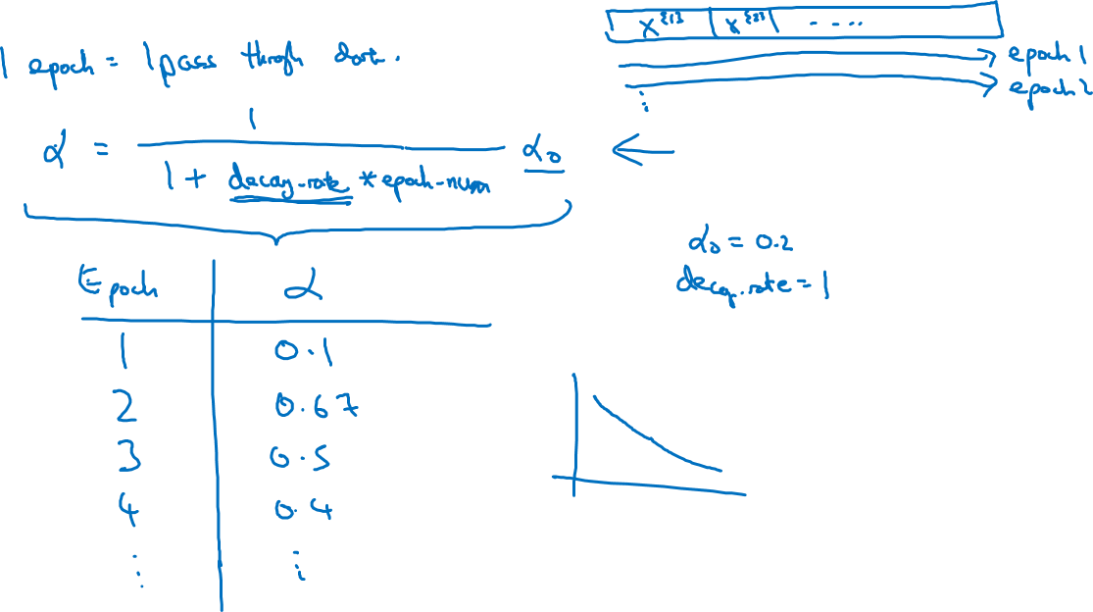
Learning rate decay

Slide 28
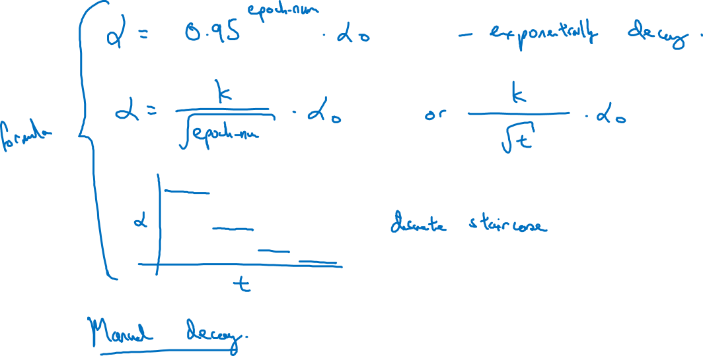
Other learning rate decay methods

Slide 29
Optimization Algorithms
The problem of
local optima
deeplearning.ai

Slide 30
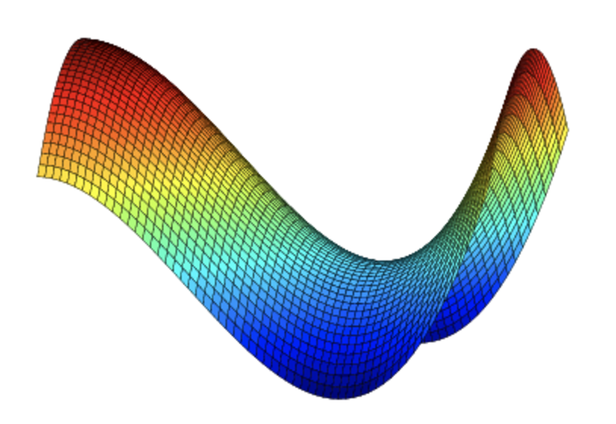
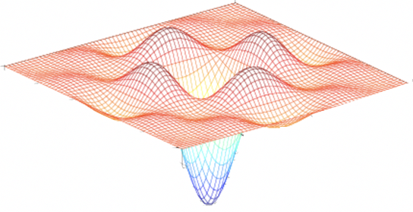
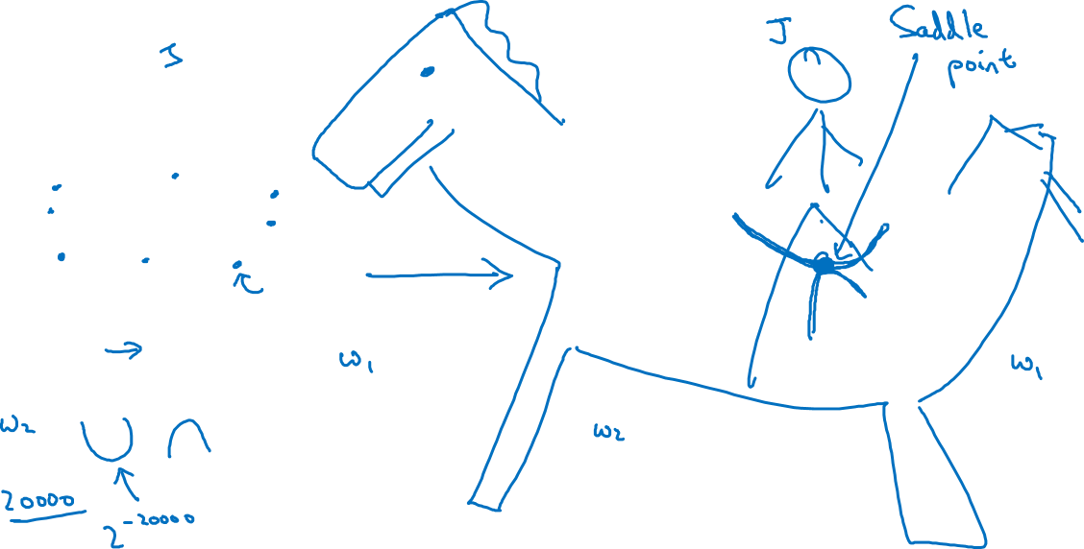
Local optima in neural networks

Slide 31

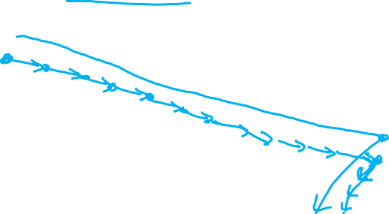
Problem of plateaus
Unlikely to get stuck in a bad local optima
Plateaus can make learning slow

